Slide 1
League of Data
Mining and Vizulaizing champion association rules with python and r

Slide 2
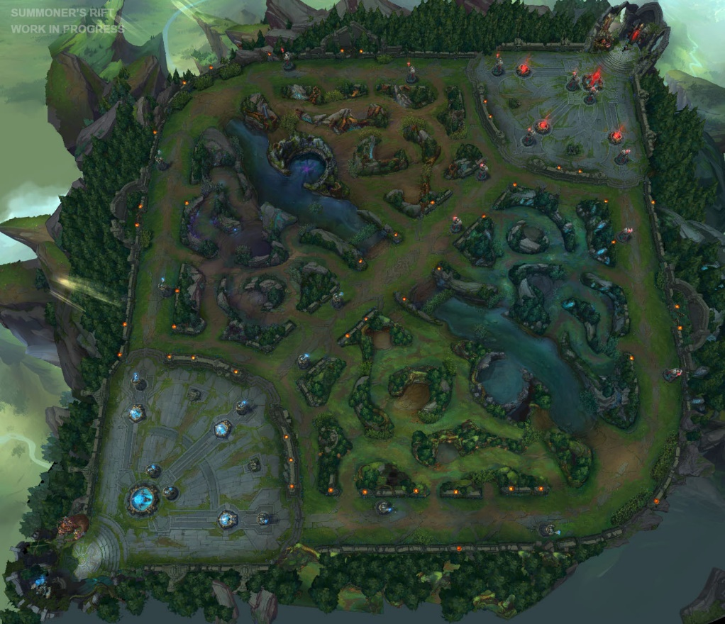
What is League of Legends
Red Side
“Multiplayer Online Battle Arena”
Most Popular PC game in the world right now (and has been for awhile)
5 champions per team, uses a draft phase complete with banning system. Randomly assigned each side, akin to white vs black in chess
Specific “Metagame” where certain champions go to a specific lane
Blue Side

Slide 3
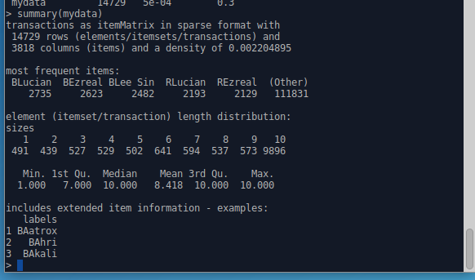
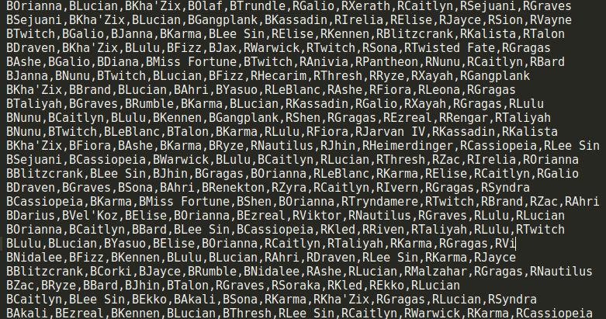
The Data
Champion names in each game, appended with “B” or “R” to designate which side they are on,
Lucian, Ezreal, Lee-Sin appear a lot in this dataset!
Gathered using “Cassiopeia” wrapper for the riotAPI in Python
~14700 games farmed over 4 days, using web recursive search of #1 ranked players match history

Slide 4
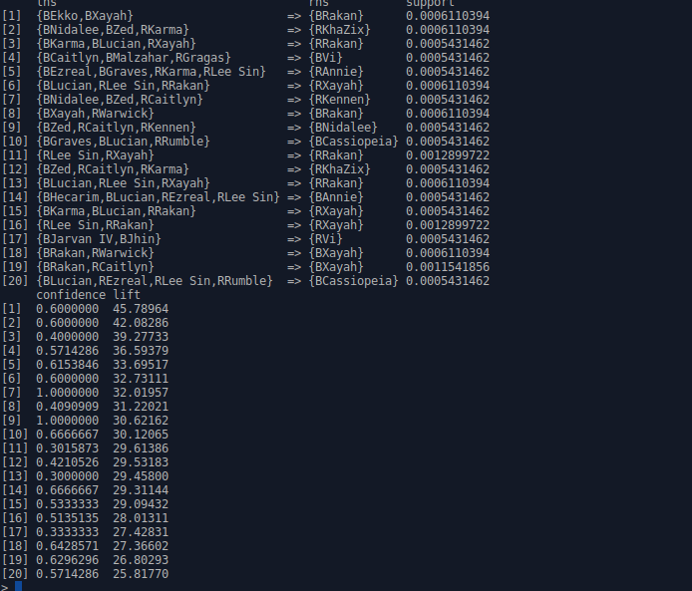
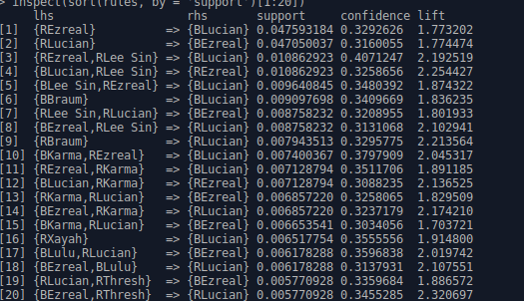
Generating Association Rules
~8000 rules generated, min support of 7 games, minimum confidence of 30%
Generated using “aRules” R package.
Algorithm extrapolated the two champions that are designed to play together! (Xayah and Rakan)
Rule 17 is very interesting, If blue-side picked Jarven and Jhin, Red Side will likely pick Vi! Vi is strong vs these champions.
Other rules mix team sides on lhs so not as interesting by themselves
Top support rules are dominated by Ezreal, Lucian, Lee-Sin, and support champions

Slide 5
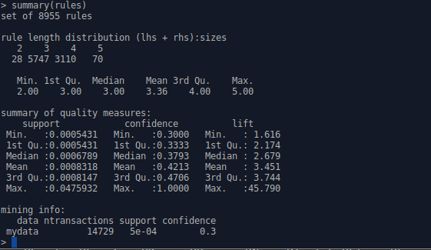
From samples to visualizations
Vast majority of rules are size 3 or 4
Mean sup = 0.0008318 * 14729 = 12 games
Mean confidence = 42%
High variance in lift, decent avg lift, we learned things!

Slide 6
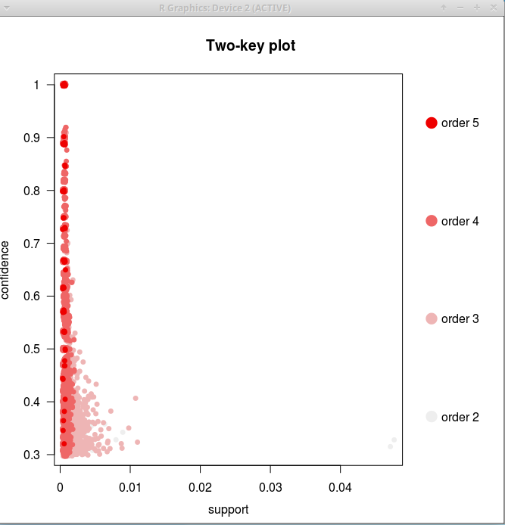
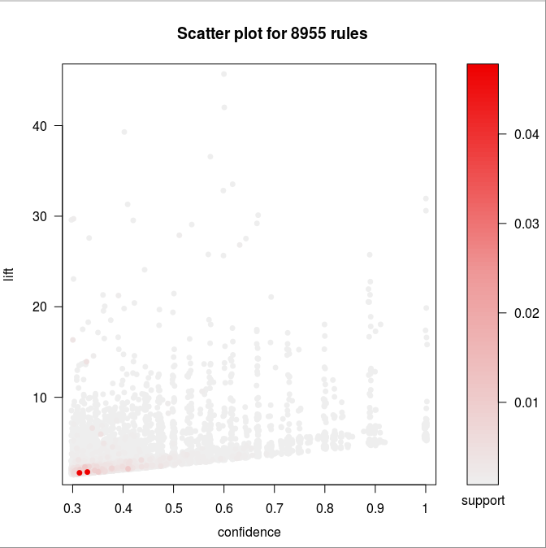
Plots of Rules
Confidence vs Support
Confidence vs Lift (and Support)
Size 2 (a-> b) and Size 3 (a, b - > c) rules had better support
Larger rules sizes had better confidence in general
Switching to confidence vs lift, we see that high lift rules had very low support (most data is sparse)
Two red dots = Lucian or Ezreal rules

Slide 7
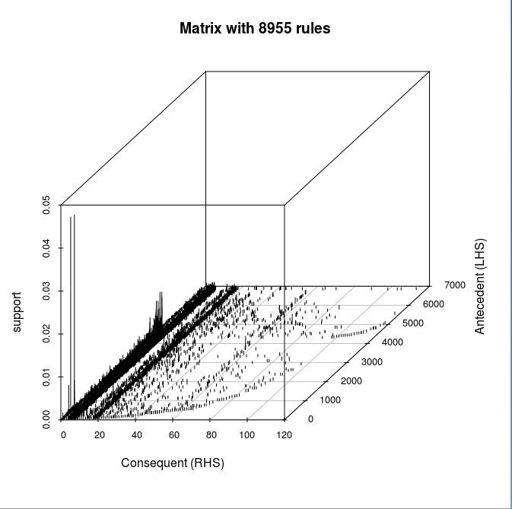
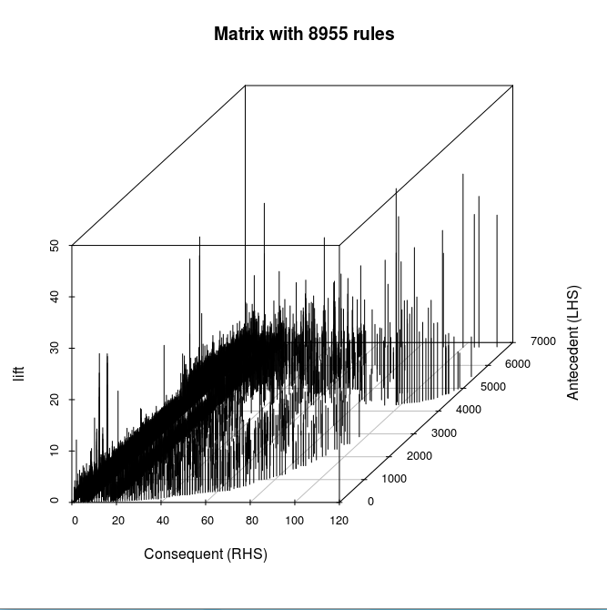
3D Matrix
Support vs Rule position
Lift vs Rule Position
Distribution is more random
Interesting
Spike
Lucian + Ezreal

Slide 8
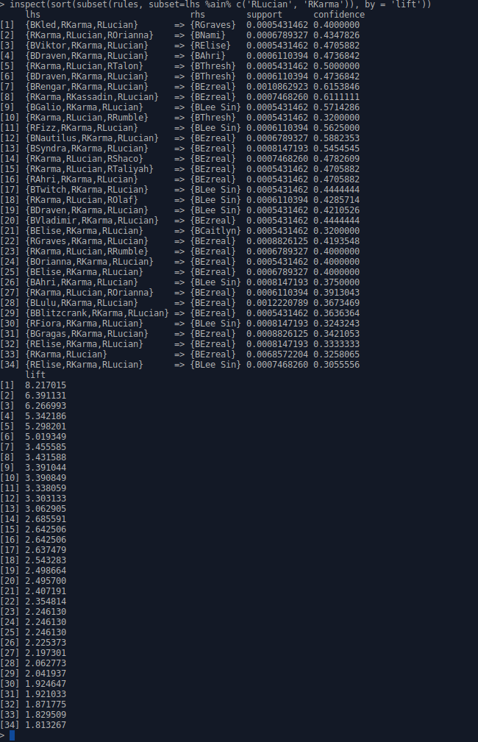
Rule Subsets
“Okay, what are all rules that have Red side Karma and Red side Lucian on the left side?
If I have both of them, and my team-mate pick Talon, than there’s a 50% chance the other team picks Thresh
Caveat: only 8 games, needs more data
Lift above avg so decent rule

Slide 9
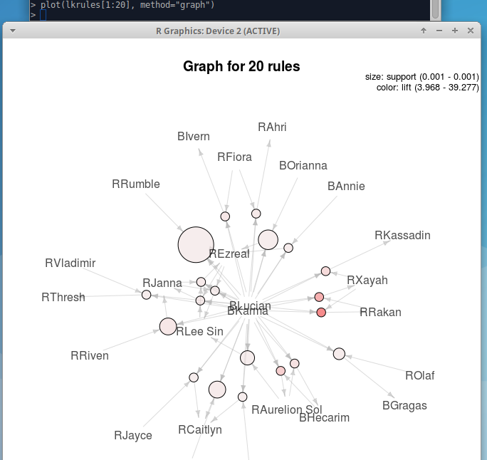
Visualizing rule subsets
*Slightly different rules, same as before but Blue-side Lucian + Blue-side Karma, notice differing rules!
Size of circle = relative support
The more red = higher lift
Xayah and Rakan show up again with high lift!

